Slide 1
The Coffee Shop @SaFaVi “Code different”
Web Application Architecture
Prof. Bruen

Slide 2
Requirements
Create, List, Delete, Update Products
Create, List, Update Persons
Create and List Orders
User Registration
Users can login to:
Register
Place orders
Update their personal information
Administrators can login to:
Maintain the list of products
Create and List persons
List Orders

Slide 3
Features - Authors
Pham Dong
Product Management
Product Category Management
Samson Weldegebriel
Order Management
Vinh Hoang
User Management – Registration
Authentication - Authorization

Slide 4
Techniques
Spring Tiles
Spring Validation
Spring Security
Spring Data JPA
Localization
REST/AJAX
Exception Handler
HTTP Multipart Request (file upload)
Github

Slide 5
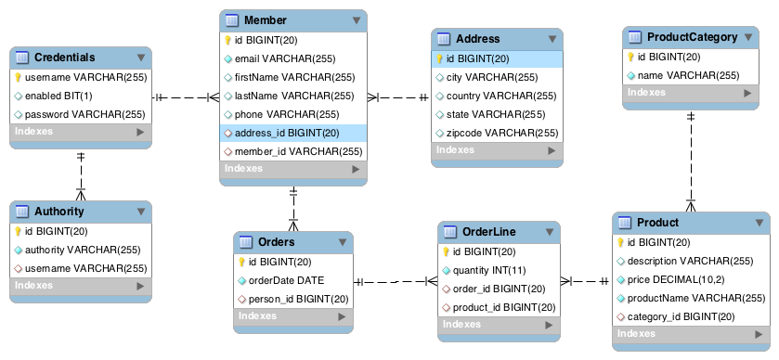
Database Design

Slide 6
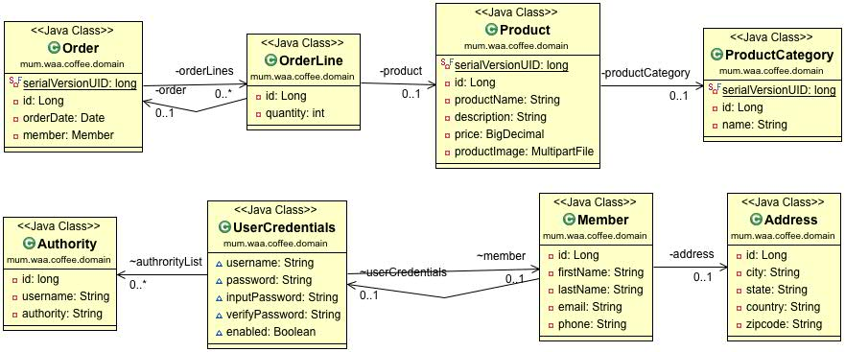
Domain Class Diagram

